Slide 1
The Open Source Operating Systems(OSOS)
CSM 255
K. O. PEASAH

Slide 2
The Basics of OSOS
Unix is a computer operating system originally developed in 1969 by a group of AT&T employees
Unix Design
-Portable
- multi-tasking
- multi-user in a time-sharing configuration.

Slide 3
Unix systems are characterized by various concepts
Plain text for storing data
Hierarchical file system
Treating devices and certain types of IPC as files
The use of a large number of software tools, small programs that can be strung together through a command line interpreter using pipes, as opposed to using a single monolithic program that includes all of the same functionality. These concepts are known as the Unix philosophy.

Slide 4
The Basics of OSOS
Under Unix, the "operating system" consists of many of these utilities along with the master control program, the kernel
What is kernel?
Is a program acting as chief operation and is responsible for starting and stopping other programs, handling requests for memory, accessing disks and managing network connections.

Slide 5
Overview of Linux OS/Getting Acquainted with Linux
What is OS?
Linux is developed and maintained by a worldwide team of volunteer programmers, working together over the Internet. Linux is great for many reasons, including the fact that the folks who built it from the ground up wanted it to be
Multiuser: More than one user can be logged in to a single computer at one time.

Slide 6
Overview of Linux OS Cont’d
Multiprocess: True preemptive multitasking enables the operating system core to efficiently juggle several programs running at once. This is important for providing multiple services on one computer.
Multiplatform: Linux currently runs on 24 platforms (hardware types), including Intel-based PCs, Digital/Compaq Alpha, PowerPC-based Apple Macintosh, Sun SPARC, Amiga, and StrongARM-based computers

Slide 7
Overview of Linux OS Cont’d
Interoperable: Linux plays nice with most network protocols (languages) and operating systems, allowing you to interact with users and computers running Microsoft Windows, Unix, Novell, both Mac OS 9 and the generation beginning with OS X, and other, more niche groups
Scalable: As your computing needs grow, you can rely on Linux to grow with you. The same Linux operating system can run on a desktop computer or a very large, industrial strength server system.

Slide 8
Portable: Linux is mostly written in the C programming language. C is a language created specifically for writing operating system-level software and can be readily ported (translated) to run on new computer hardware. As your computing needs grow, you can rely on Linux to grow with you. The same Linux operating system can run on a desktop computer or a very large, industrial strength server system.

Slide 9
Flexible: You can configure the Linux operating system as a network host, router, graphical workstation, office productivity PC, home entertainment computer, file server, Web server, cluster, or just about any other computing appliance that you can think of.

Slide 10
Overview of Linux OS Cont’d
Stable: The Linux kernel (the operating system) has achieved a level of maturity that makes most software developers envious. It’s not uncommon to hear reports of Linux servers running for years without crashing.
Efficient: The modular design of Linux enables you to include only the components needed to run your desired services. Even older Pentium computers can utilize Linux and become useful again.

Slide 11
Overview of Linux OS Cont’d
Free!: To most people, the most intriguing aspect of Linux is the fact that it’s often available free of charge. How (the capitalists murmur) can anyone build a better mousetrap with no incentive of direct monetary return?
NOTE: OS may adopt one of many different scheduling strategies

Slide 12
Multitasking
A method by which multiple tasks, also known as processes, share common processing resources such as a CPU
The act of reassigning a CPU from one task to another one is called a context switch.
Even on computers with more than one CPU (called multiprocessor machines), multitasking allows many more tasks to be run than there are CPUs

Slide 13
Multiprogramming
In multiprogramming systems, the running task keeps running until it performs an operation that requires waiting for an external event (e.g. reading from a tape) or until the computer's scheduler forcibly swaps the running task out of the CPU. Multiprogramming systems are designed to maximize CPU usage.

Slide 14
Time Sharing
In time-sharing systems, the running task is required to relinquish the CPU, either voluntarily or by an external event such as a hardware interrupt. Time sharing systems are designed to allow several programs to execute apparently simultaneously. The expression 'time sharing' was usually used to designate computers shared by interactive users at terminals, such as IBM's TSO, and VM/CMS

Slide 15
Process Management
Three basic state of an O.S
1. ACTIVE(RUNNING)
the process has control over the CPU
2. READY
3. BLOCKED( “Sleeping”, “Waiting”)

Slide 16
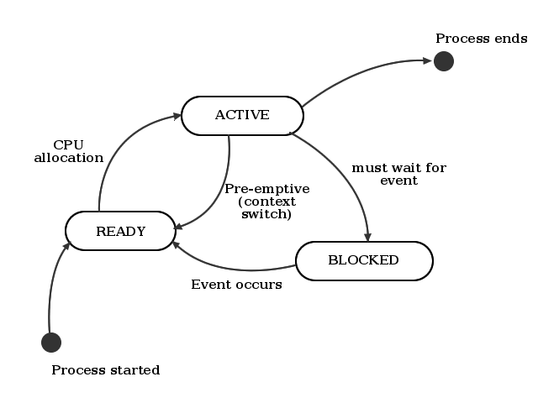
STATE MODEL

Slide 17
THE READY PROCESS
Processes compete for allocation of CPU
Contained in one or more queues(ready queue)

Slide 18
THE READY PROCESS
The OS has two components for allocation the CPU
1. Scheduler :- strategy and planning of allocation
2. Dispatcher: - does allocation and context switch

Slide 19
Note:
We distinguish
1. Non-preemptive scheduling(Cooperative multitasking).
2. Preemptive scheduling(full multitasking)

Slide 20
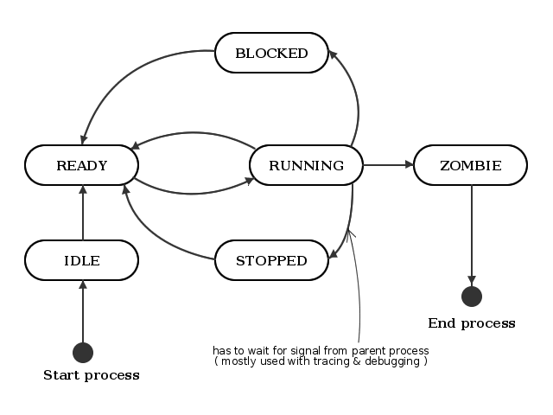
State Model of Unix/Linux

Slide 21
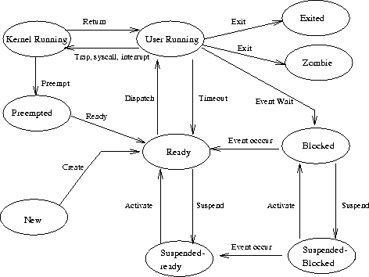
Process creation in UNIX

